Slide 1
Heart Failure Analysis
Presented by –
Group 10:
Ahfaz Abdul, Sai Sushama Nimmagadda, Harish Babu Ramineni

Slide 2
Introduction
Analyzed clinical records of 299 heart failure patients.
Aim: Identify key predictors, trends, and insights to enhance detection and interventions.
Features: Age, serum creatinine, ejection fraction, lifestyle factors, and more.
Notes:
The introduction of the presentation outlines a project focused on analyzing Heart Failure Clinical Records to identify key predictors and trends that can improve patient management. The project targets an important medical challenge: understanding the factors contributing to heart failure outcomes and developing methods for early detection and targeted interventions.
Project Objective:
The primary goal is to analyze clinical records of 299 heart failure patients to extract meaningful insights using visualization techniques, clustering methods, and feature analysis. By leveraging advanced data analysis tools, the study seeks to highlight significant predictors and trends that can guide healthcare practitioners in diagnosing and managing heart failure more effectively.

Slide 3
Data
Source: Heart Failure Clinical Records Dataset.
Features Collected:
Clinical (e.g., serum creatinine, ejection fraction).
Demographic (e.g., age, sex).
Lifestyle (e.g., smoking, diabetes).
Notes:
Dataset:
The dataset includes information from 299 patients, capturing 13 distinct features. These features range from clinical metrics, such as serum creatinine, ejection fraction, and time, to demographic and lifestyle factors like age, smoking habits, and medical history. The diverse nature of the dataset provides a comprehensive view of the variables affecting heart failure outcomes.

Slide 4
Methods
Data Preprocessing:
Handled missing and negative values, scaled features, and engineered a Total column.
Clustering:
Used KMeans, Agglomerative Clustering, and DBSCAN to group patients.
Exploratory Data Analysis (EDA):
Visualized trends (e.g., age distribution, correlations).
Regression Analysis:
Applied OLS, Lasso, Ridge, and ElasticNet to identify key predictors.
Notes:
Methodology:
The project employs a multi-step analytical approach:
Exploratory Data Analysis (EDA): Visualization techniques, including scatter plots, pie charts, line plots, bar plots, and heatmaps, are used to explore feature distributions and relationships. This step helps in identifying significant trends and correlations within the data.
Clustering Algorithms:
K-means clustering: Used to segment patients into groups based on similar characteristics.
Agglomerative clustering and DBSCAN: Applied to identify outliers and unique cases that might deviate from common patterns.
Regression Analysis:
Several regression models (OLS, Linear, Lasso, Ridge, ElasticNet) are tested using 5-fold cross-validation to predict outcomes and identify the most impactful features. These models help in quantifying the importance of variables and their contributions to patient outcomes.

Slide 5
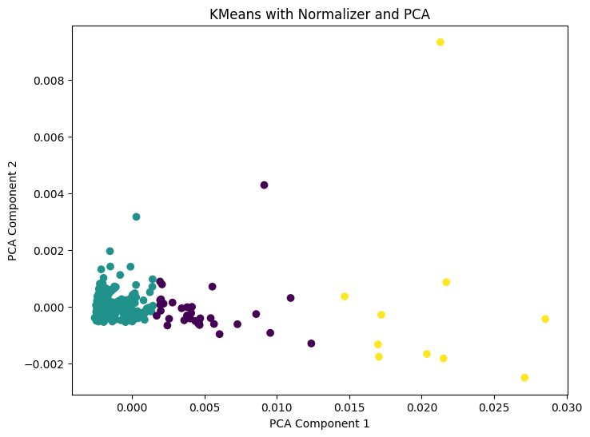
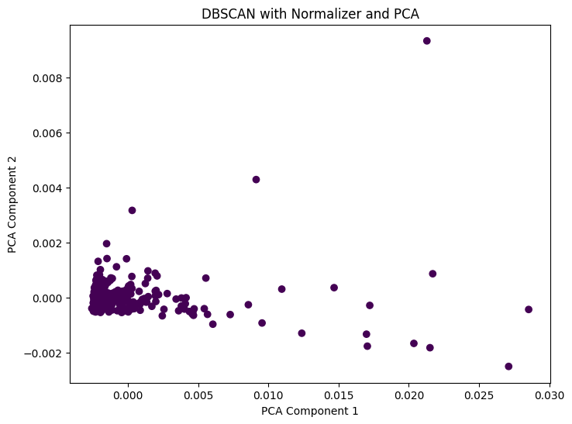
Clustering
Notes:
Clusters: Represent groups of patients with similar clinical profiles. Grouping Logic: Patients are grouped by similarity in scaled feature values.
PCA's Role: Simplified the data to 2D, enabling efficient clustering while retaining meaningful variance.
add this notes in clustering Clustering techniques like KMeans, Agglomerative Clustering, and DBSCAN grouped patients based on clinical, demographic, and lifestyle features, while PCA was likely used to reduce dimensionality and enhance clustering efficiency and visualization . The two graphs represent clustering results after applying normalization and PCA (Principal Component Analysis):
DBSCAN (Density-Based Spatial Clustering of Applications with Noise):
Points are mostly clustered together, with some spread indicating potential noise or outliers.
DBSCAN is effective in identifying outliers but struggles to form distinct clusters in this case due to the lack of clear density-based separations.
KMeans Clustering:
Points are segmented into distinct clusters (denoted by different colors: teal, purple, and yellow).
KMeans clearly identifies three groups, making it more effective for partitioning data into meaningful segments.
Comparison and Recommendation:
DBSCAN: Better for outlier detection but less effective at segmenting this dataset into meaningful clusters.
KMeans: Performs better here, with well-defined clusters, indicating clearer insights into groupings. Conclusion: KMeans is the better clustering method for this dataset, as it creates more interpretable and distinct clusters compared to DBSCAN.

Slide 6
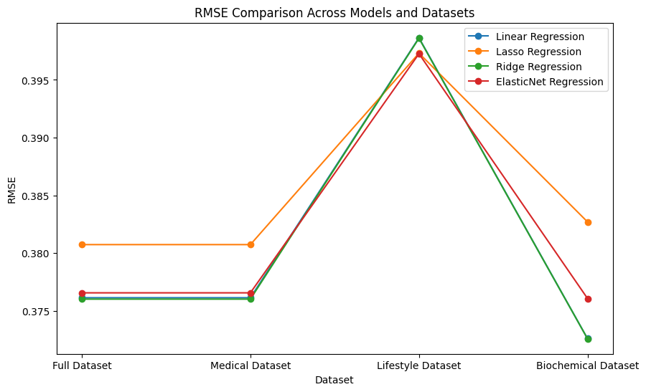
Which model did better?
Notes:
Based on the RMSE (Root Mean Square Error) graph:
Best Performing Model: ElasticNet Regression has the lowest RMSE across most datasets, especially in the Biochemical Dataset, indicating better accuracy.
Second Best: Ridge Regression closely follows ElasticNet with comparable RMSE, making it a good alternative.
Least Effective: Lasso Regression consistently shows higher RMSE compared to other models, particularly on the Lifestyle Dataset.
Conclusion:
ElasticNet Regression is the best model for this analysis due to its overall lower RMSE, indicating better predictive performance.

Slide 7
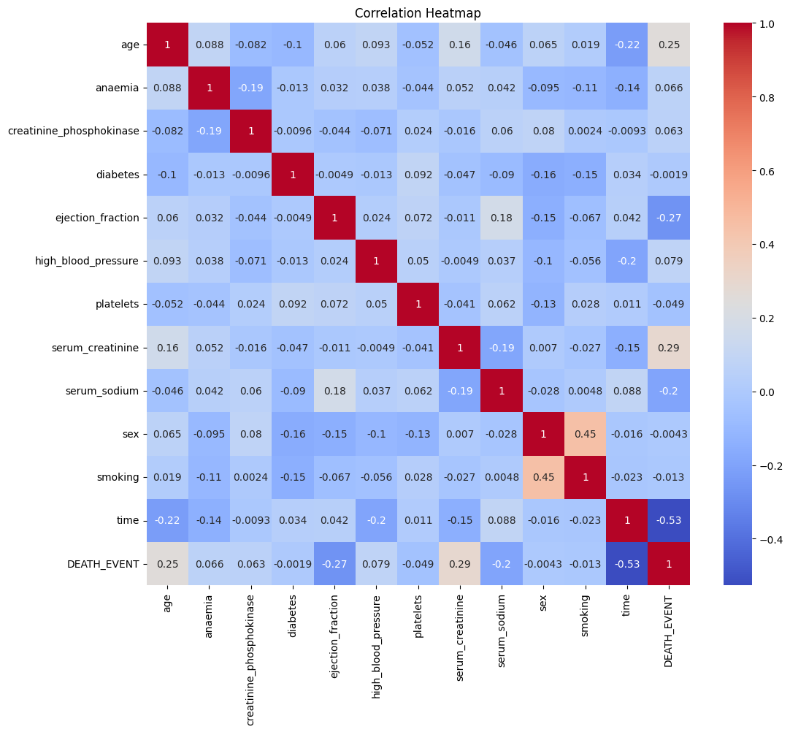
What is the correlation between features?
Notes:
The heatmap shows the following key correlations:
Strong Positive: Serum creatinine with death events (0.29) and sex with smoking (0.45).
Strong Negative: Time with death events (-0.53) and ejection fraction with death events (-0.27).
Other Notable: Age weakly correlates with death events (0.25), while serum sodium shows a weak negative correlation (-0.20).
These insights highlight critical features influencing heart failure outcomes.

Slide 8
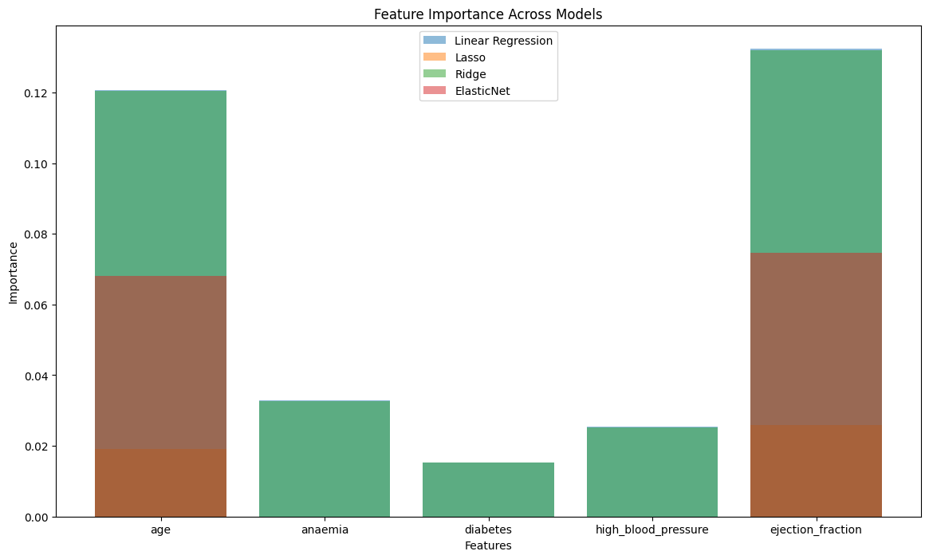
Which is the important feature?
Notes:
Age and ejection fraction are the most important predictors across all models, with high contributions. Anaemia and high blood pressure have moderate importance, while diabetes has minimal impact on predictions.

Slide 9
Key Results
Predictors of Heart Failure:
Serum creatinine, ejection fraction, and follow-up time are critical.
Clustering Insights:
KMeans revealed distinct patient clusters, while DBSCAN identified outliers.
Visualization Highlights:
Age, smoking, and diabetes showed varying impacts on outcomes.

Slide 10
Discussion:
If generalized, results imply that focusing on key predictors like serum creatinine and ejection fraction can guide early detection and interventions.
Limitations: Confounding variables and dataset scope require further validation.

Slide 11
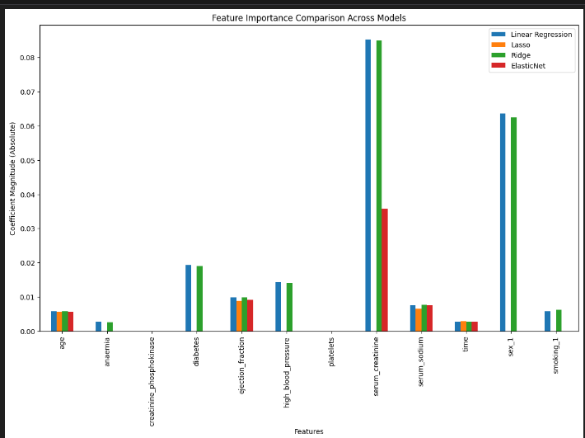
Conclusion:
Serum creatinine and ejection fraction are top predictors.
Notes:
This graph compares feature importance (coefficient magnitudes) across Linear, Lasso, Ridge, and ElasticNet regression models. Here's the explanation:
Most Important Features:
Serum Creatinine: Highest importance across all models, especially for Linear Regression, indicating it is the strongest predictor of outcomes.
Ejection Fraction and Time: Consistently important across all models, reinforcing their critical role in predicting heart failure.
Moderate Importance:
Sex and Serum Sodium: Show moderate contribution in all models but less impactful than serum creatinine and ejection fraction.
Least Important Features:
Creatinine Phosphokinase, Platelets, Anaemia, and Smoking: Low importance across all models, suggesting limited predictive value for heart failure in this dataset.
Key Takeaway:
Serum creatinine, ejection fraction, and time are the most critical features across all regression methods, while others play smaller roles. This consistency across models validates their importance for predicting heart failure outcomes.

